Slide 1
Bayesian framework to quantify uncertainty in water accounting in NSW catchments
R.W. Vervoort^{1,2}, J Simmons^{1,2}, G. Francis³, R. Scalzo³
¹ARC Industrial Transformation Training Centre Data Analytics for Resources and the Environment
²School of Life and Environmental Sciences, the University of Sydney, NSW 2006
³Data61 CSIRO, Australia
We acknowledge the traditional owners of the land on which we present today, and pay respect to their elders, past, present and emerging

Slide 2
“Where is all the Water”
Multi-disciplinary and multi-institutional project focused on understanding uncertainties in:
Catchment scale water accounting (for example the whole of the Namoi)
Groundwater Surface water interaction
Groundwater Recharge quantification
Combination of new sensing technologies and data science approaches
DARE focused on a Bayesian approach to uncertainty quantification
Funded by NSW DPE and the NSW Office of the Chief Scientist and Engineer

Slide 3
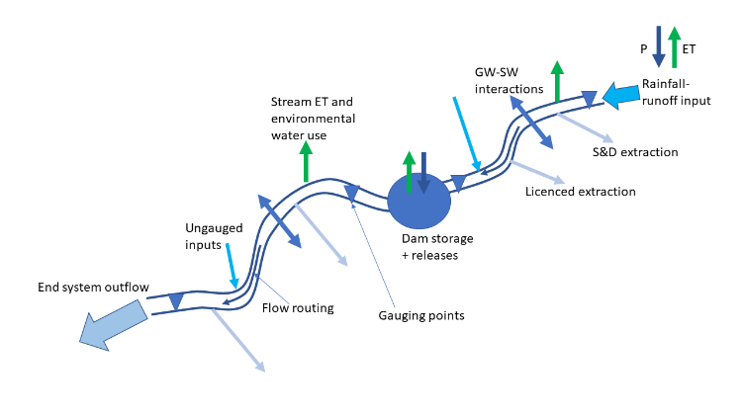
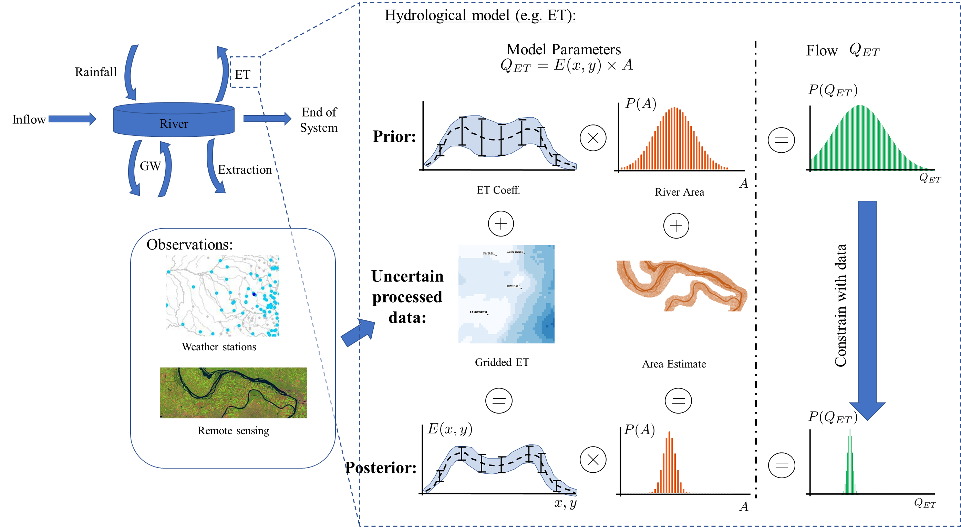
Where is all the Water??
Uncertainty quantification of the water balance
Develop probability distributions to describe each uncertain component within a catchment model.
Demonstrate uncertainty quantification of ET, stream gauging and groundwater modelling
Focussing on groundwater as a first step
Groundwater data is quarterly (mostly): limiting time interval

Slide 4
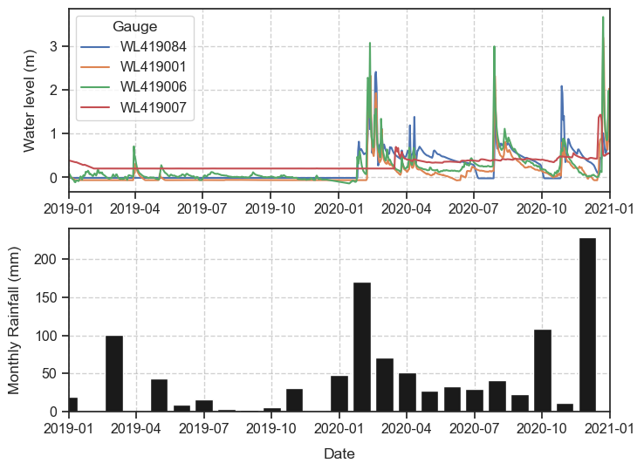
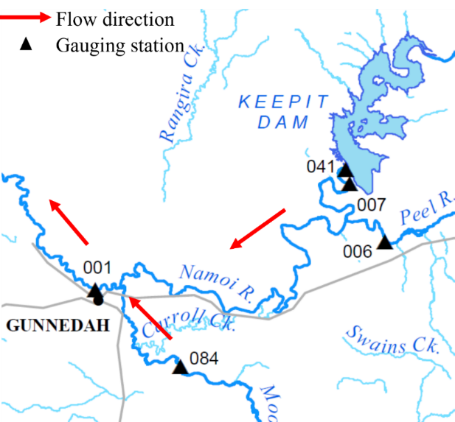
Data
Pilot study of a “dry use case” between Keepit Dam and Gunnedah for 2019/2020
Data from 2019 show very little rainfall and associated streamflow in the four gauges characterising inflows/outflows

Slide 5
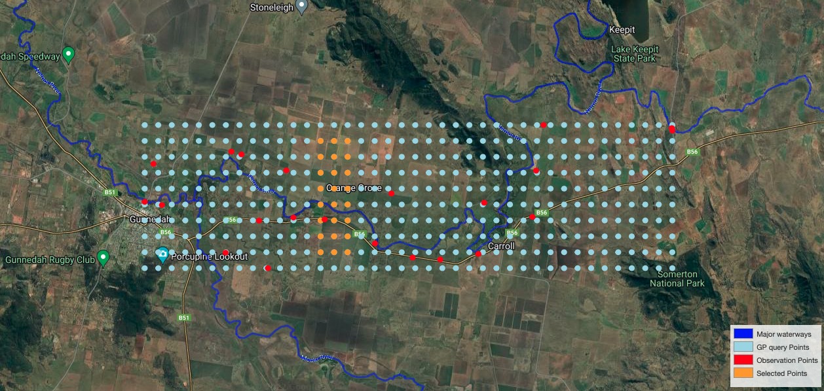
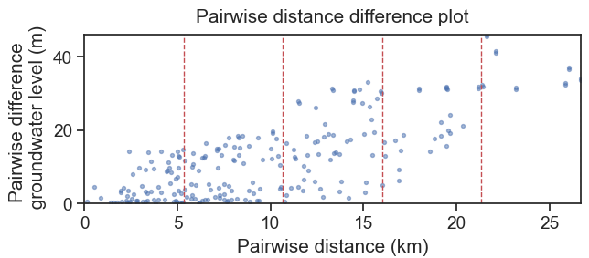
A Bayesian model of a connected river
A first approach to the problem
Gaussian Process (GP) modelling
Assuming continuity between groundwater level and stream flow
Connected system
Based on available data, there are 8 time slices with sufficient data.
21 data points in space
Can GPs provide alternative approaches for numerical groundwater modelling?

Slide 6
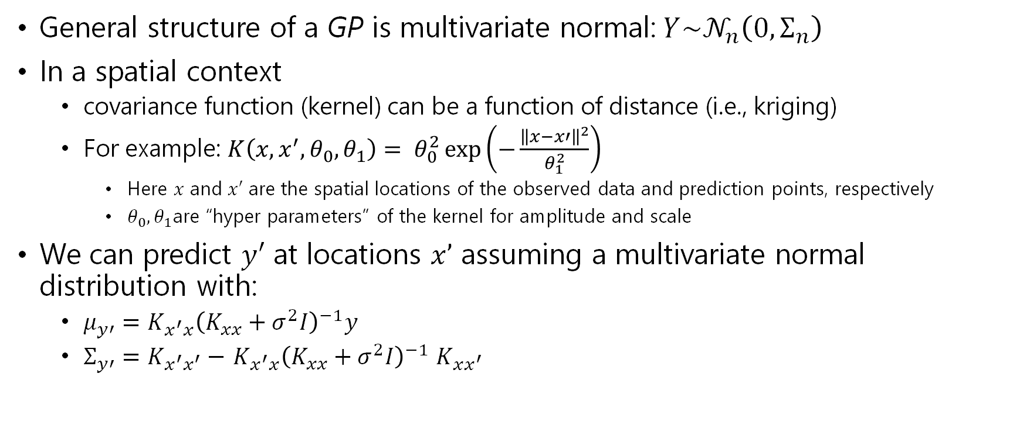
Gaussian Process models
General structure of a GP is multivariate normal:$Y\sim 𝒩_{n}\left(0, Σ_{n}\right)$
In a spatial context
covariance function (kernel) can be a function of distance (i.e., kriging)
For example: $K\left(x,x^{′},θ_{0},θ_{1}\right)= θ_{0}^{2}\exp\left(−\frac{{\left\|x−x′\right\|}^{2}}{θ_{1}^{2}}\right)$
Here $x$ and $x′$ are the spatial locations of the observed data and prediction points, respectively
$θ_{0}, θ_{1}$are “hyper parameters” of the kernel for amplitude and scale
We can predict $y′$ at locations $x’$ assuming a multivariate normal distribution with:
$μ_{y′}=K_{x^{′}x}{\left(K_{xx}+σ^{2}I\right)}^{−1}y$
$Σ_{y′}=$ $K_{x^{′}x^{′}}−$ $K_{x^{′}x}{\left(K_{xx}+σ^{2}I\right)}^{−1}$ $K_{xx^{′}}$
Notes:
Squared exponential
Amplitude and scale are similar to nugget and range in kriging
X’ is prediction point

Slide 7
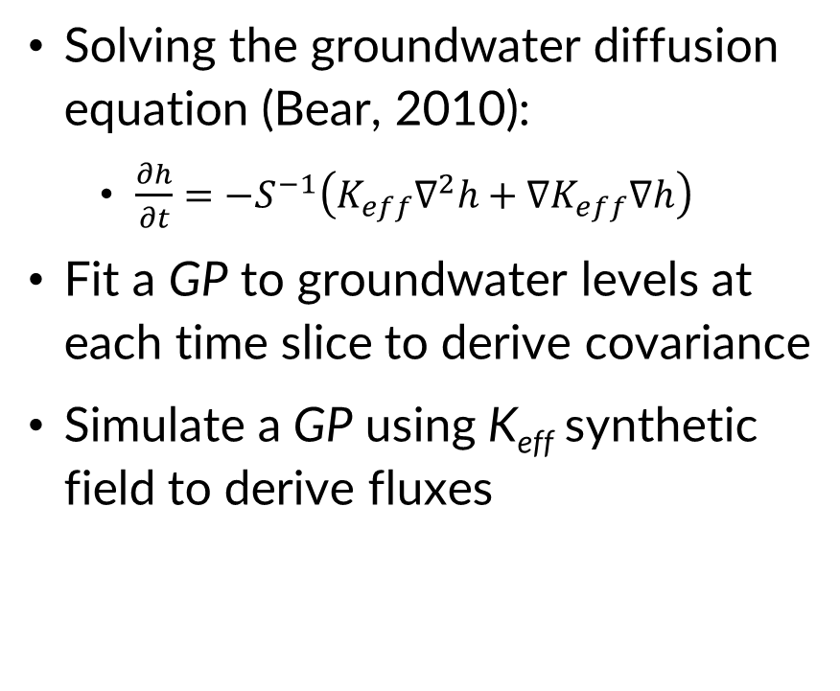
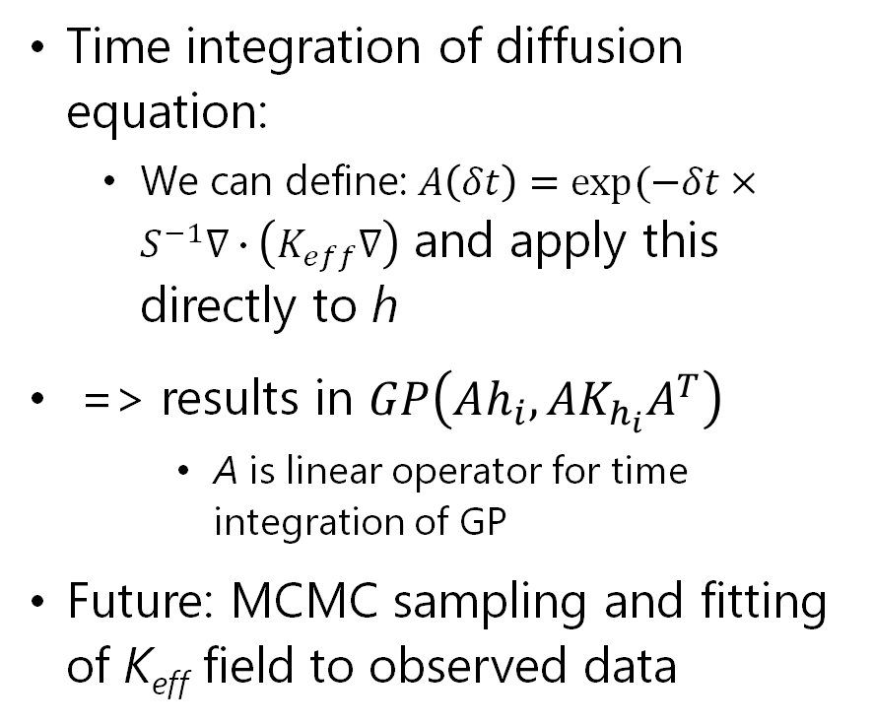
Application to groundwater modelling
Solving the groundwater diffusion equation (Bear, 2010):
$\frac{∂h}{∂t}={−S}^{−1}\left(K_{eff}∇^{2}h+∇K_{eff}∇h\right)$
Fit a GP to groundwater levels at each time slice to derive covariance
Simulate a GP using K_{eff} synthetic field to derive fluxes
Time integration of diffusion equation:
We can define: $A\left(δt\right)=exp⁡(−δt×S^{−1}∇∙\left(K_{eff}∇\right)$ and apply this directly to h
=> results in $GP\left(Ah_{i},AK_{h_{i}}A^{T}\right)$
A is linear operator for time integration of GP
Future: MCMC sampling and fitting of K_{eff} field to observed data
Notes:
Time integration could be using a numerical solution, but can be also done in a closed form using the A(deltat), assuming small innovations.
An alternative would be a 2nd order Runge Kutta or other numerical scheme
The main point is that the time integration, whether numerical or closed form is a linear operator, so the integral of a GP is still a GP, with a changed covariance function.
Space-time covariance is captured by the linear operator "A".
A provides the time integration for each slice, but all of the time slices are treated as independent
Mean function of GP is given as Ah_i, meaning it's whatever you'd get with the deterministic numerical integration technique that A implements.
Main thing here is again that integration, whether closed form or numerical, is a linear operator and so the integral of a GP is also a GP with transformed covariance

Slide 8
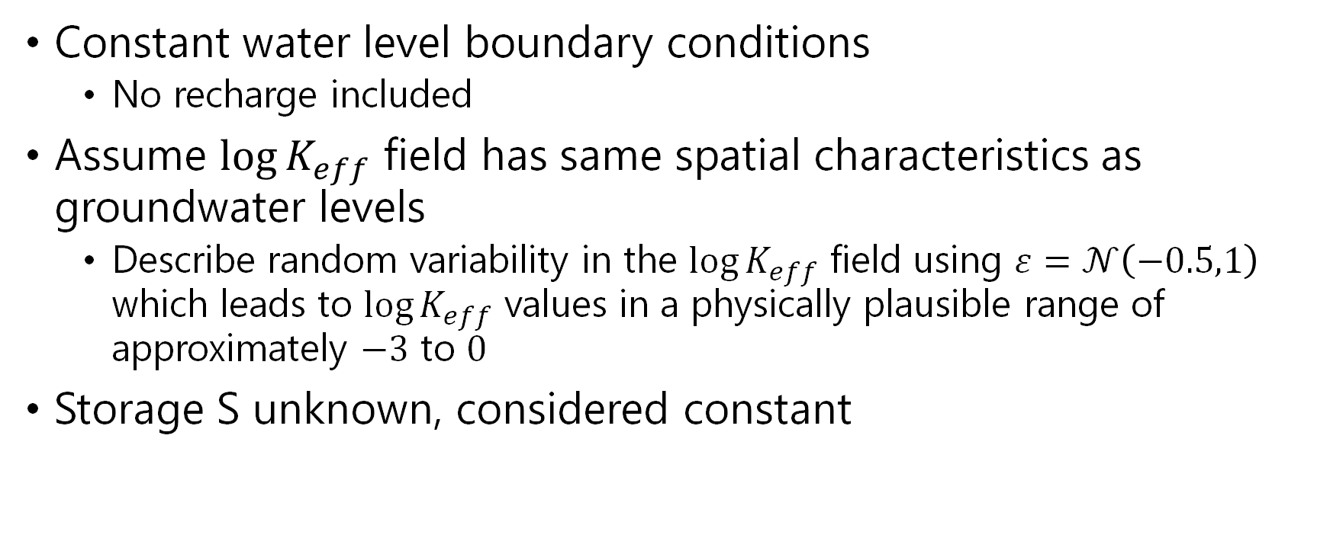
Assumptions and priors
Constant water level boundary conditions
No recharge included
Assume $\log{K_{eff}}$ field has same spatial characteristics as groundwater levels
Describe random variability in the $\log{K_{eff}}$ field using $ε=𝒩\left(−0.5,1\right)$ which leads to $\log{K_{eff}}$ values in a physically plausible range of approximately $−3$ to $0$
Storage S unknown, considered constant
Notes:
Talk about epsilon , Keff is purely synthetic
Choices of epsilon have influence on the results.

Slide 9
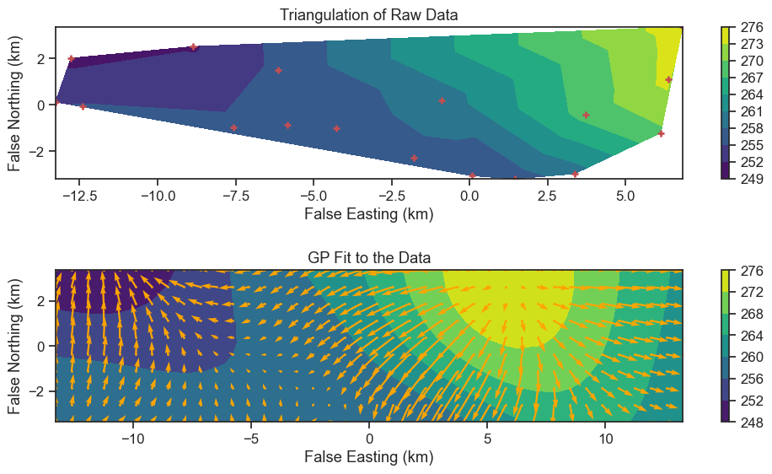
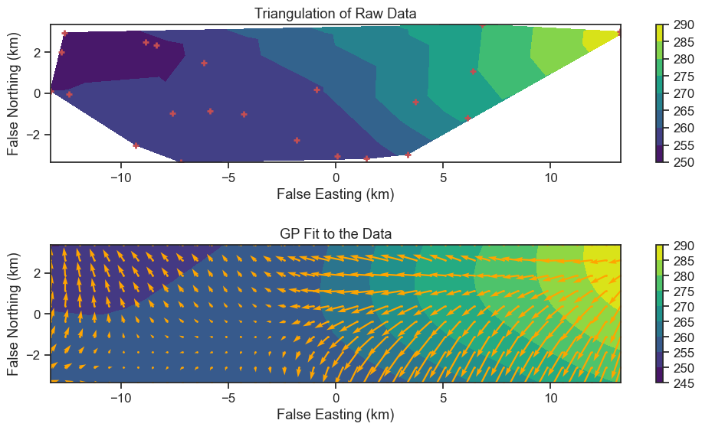
Results - GP fit to borehole data
03-2020
08-2020
Notes:
The first step is the fit of a GP to the groundwater level data

Slide 10
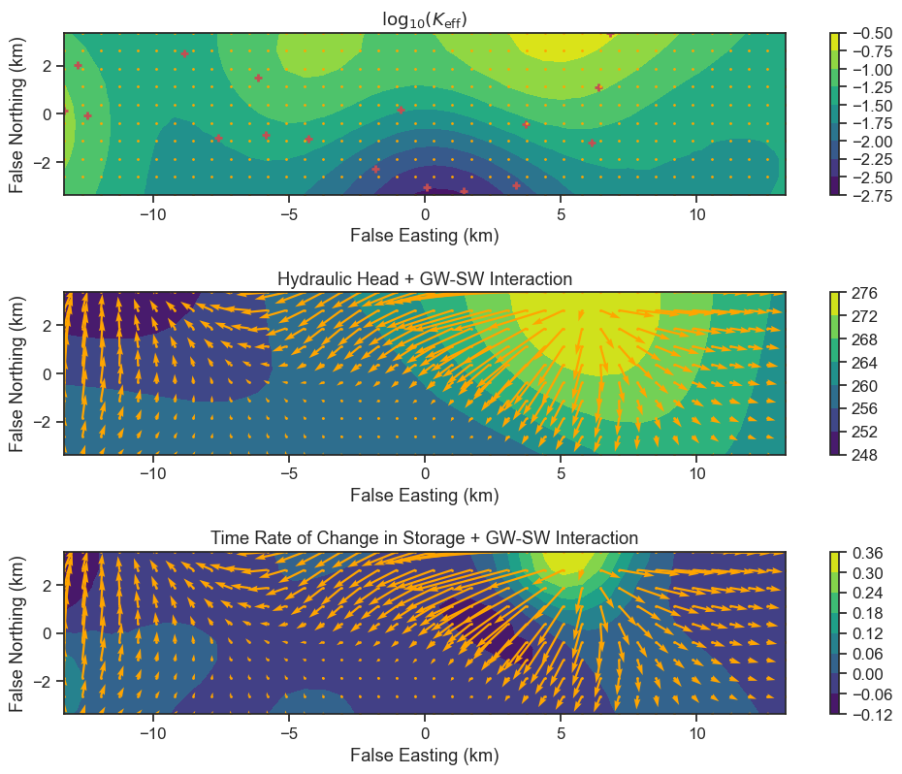
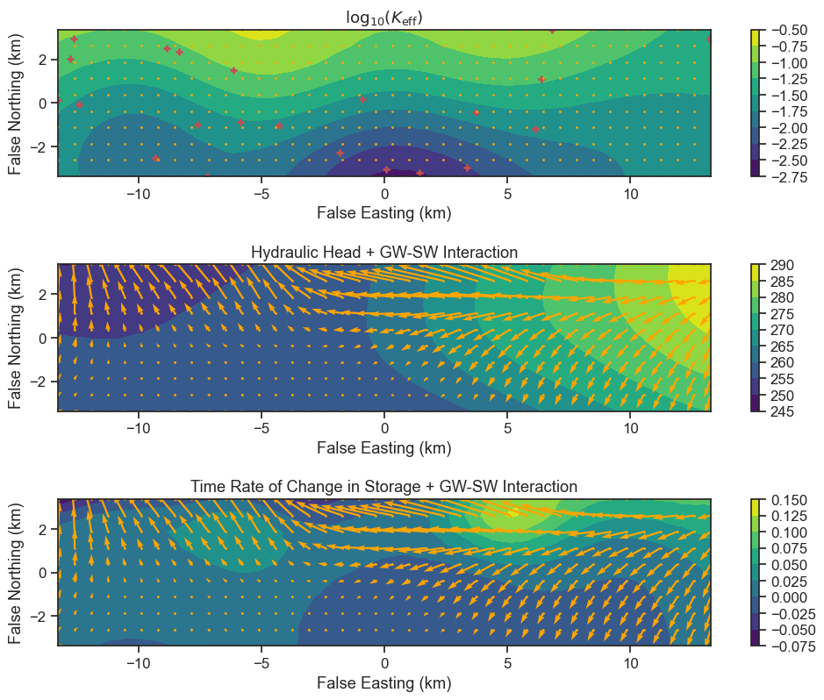
Results - spatial fluxes
03-2020
08-2020
Notes:
Based on the GP, we can generate a log Keff field (purely synthetic at this point) and this allows calculation of changes in storage and fluxes for GW-SW interactions.
The fields are different for each time slice as they depend on the actual observed data

Slide 11
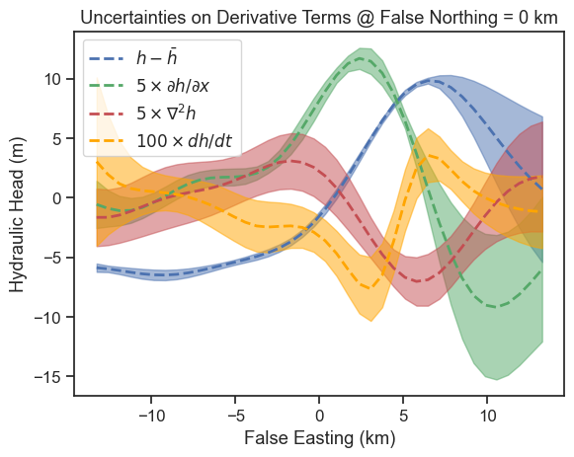
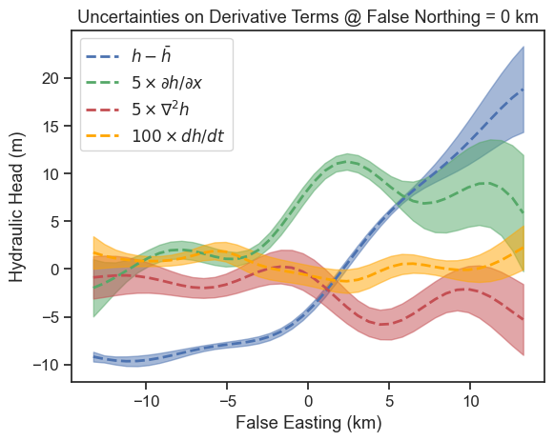
Results – E-W slice with uncertainty
03-2020
08-2020
Notes:
Highlights the areas with the largest uncertainties

Slide 12
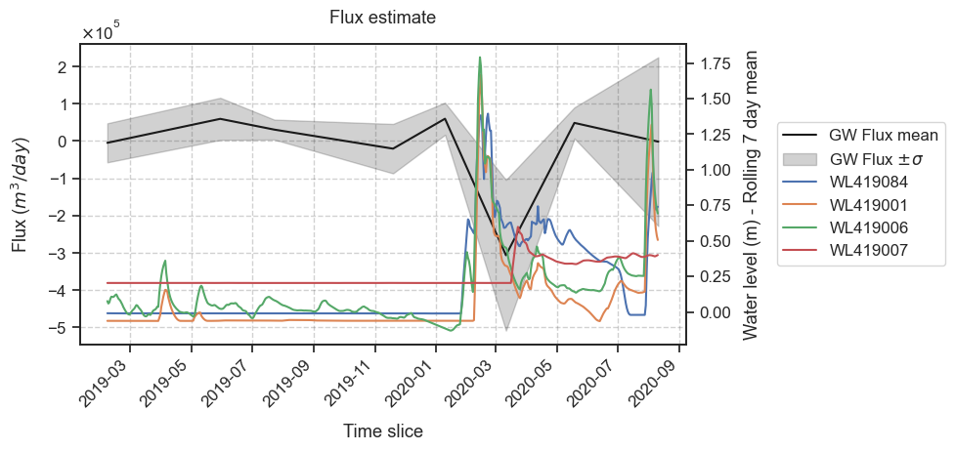
Results - temporal fluxes

Slide 13
Discussion and future work
Current example is a synthetic “toy” example.
Entirely GP-based and can be integrated readily with traditional Bayesian optimization when you have very little data.
Data are limited, observations are fairly sparse
Mesh free integration in time and space, more efficient than classical groundwater modelling?
Future work
Infer K_{eff} using MCMC
Linking the K_{eff} covariance function and storage estimates to lithology
Including recharge from rainfall
Current GP fit is “from scratch”, GPyTorch might offer efficient alternatives

Slide 14
Conclusions
Groundwater fluxes can be resolved using GP modelling of water levels;
Without clear priors and constraints on parameters, examples provide insight, but no realism;
Potential extension can provide efficient approaches to groundwater modelling.

